Slide 1

RUNGTA COLLEGE OF DENTAL SCIENCES & RESEARCH
TITLE OF THE TOPIC: GINGIVAL TISSUE
MANAGEMENT
DEPARTMENT OF CONSERVATIVE DENTISTRY AND ENDODONTICS

Slide 2
Specific learning Objectives
At the end of this presentation the learner is expected to know
Core areas* H | Domain ** | Category #
Definition, classification, indication, contraindication | Cognitive | Must know
Techniques of retraction | Psychomotor | Nice to know
Recent advances, History | Affective | Desire to know
*Subtopic of importance
** Cognitive, Psychomotor or Affective
# Must know , Nice to know & Desire to know

Slide 3
Table of Content
Introduction
Definition
Biological width
Indication
Classification
Techniques of retraction

Slide 4


Slide 5
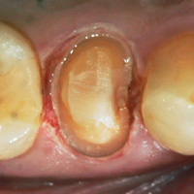
In the context of general operative treatment procedures, Gingival tissue management relates to the various techniques applied in order to displace gingival tissue from the proposed operating site .
Such gingival tissue displacement is often required in order to carry out the principles of cavity design and restoration.
Notes:
Gingival displacement instead of gingival retraction

Slide 6
The goal of the procedure is to reversibly displace the gingival tissues in a lateral direction so that a bulk of low-viscosity impression material can be introduced into the widened sulcus and capture the marginal detail.
Critical sulcular width - 0.2 mm
Optimal position of cervical margin in sulcus from healthy free gingiva margin - 0.5mm
Optimal position of cervical margin in sulcus from crest of the alveolar bone -3.0 to 4.0 mm
Notes:
Critical sulcular width needed for this purpose is 0.2 mm.. Gingival sd be healthy if inflammed gtm is difficult and may result in recession .

Slide 7
Indications
Cavity preparation extends into the subgingival area as in class II and class V cavity preparation.
Aesthetics.
Making impression in area of gingival sulcus.
Enhancing the retention
Removal of Gingival overgrowth hindering operative procedure .
Control gingival haemorrhage or fluid flow during operative procedure.
Notes:
Retenttion – increase clinicl crown length

Slide 8
Prerequisites
Free gingival margin at normal healthy position, with no recession .
Sound periodontium .
The dimension of reduction of free gingival margin should be done in a way so that the gingiva will regain its dimension after completion of the procedure .
Crevicular fluids and bleeding should be completely arrested .
The process should not induce irreversible trauma to the free gingiva ,walls of gingival sulcus or any part of the periodontium.

Slide 9
Difficult in
Inflammed gingiva .
Area of gingival recession.
Inadequate attached gingiva .
Prepared margins are placed too deep in the sulcus .

Slide 10
A gingival retraction agent should be :
Effective for its intended use.
Safe- both locally and systemically.
The effects should be spontaneously reversible, wearing off in a short time.
No permanent tissue displacement.
Free gingiva –temporarily reduced.
Expose gingival termination.
Crevicular fluids,bleeding- arrested

Slide 11
HISTORY
d’Arsonvol (1891)- electrosurgery
Pascal 1947 - 8% buffered solution of racemic epinephrine HCl (called Racemistat) for use in the dental profession.
Amsterdam 1954- rotary curettage
1956- Gingi-pak [Belport]
Pascord 1966-Aluminum Sulfate instead of epinephrine as an astringent
Retrax 1974- twisted cord without medicament
Notes:
Racemic- equal amont of both isomers are present 50-50%. Eg dextro and levo epi 50 50 % present in racemic epinephrine.=1/100 dose of epinephrin

Slide 12
Means of gingival tissue management
Marzouk :
1. Physiomechanical means
2. Chemical means
3. Electrosurgical means
4.Surgical means
Notes:
Or the combination of all

Slide 13
B.W. Benson (1986):
1.Mechanical methods.
2. Mechanico-chemical methods.
3. Rotary gingival curettage.
4. Electrosurgical method.
J Dent Res 70(11):1447-1449, November, 1991

Slide 14
Rosenteil, Land, Fujimoto
Mechanical
Chemical
Surgical
Electrosurgery
LASERS

Slide 15
DCNA:
Mechanical
Chemical
Surgical
Rotary gingival curettage.
Electrosurgical method.
4. Combination of three
Donovan et al DCNA 2004 433-444

Slide 16
Physiomechanical method

Slide 17
Rapid and easy method.
Constitutes mechanically forcing the gingiva away from the tooth surface, laterally and apically.
Indicated for absolutely healthy gingiva with good vascular supply and adequate attached gingiva .

Slide 18
Methods
Rubber dam
Custom temporary restoration.
Rolled Cotton twills
Cotton twills combined with ZOE
Retraction cords
Wooden wedges
Copper bands

Slide 19
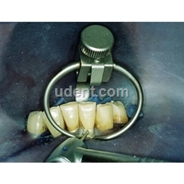
Rubber dam
Advantage
Most efficient in controlling tissue fluid and hemorrhage.
Easy application.
Limitation-
Cant be used in cases where severe cervical extention is needed.
Notes:
Its an cervical retracting clamp.

Slide 20
Cotton Twills
Used when eversion needed is :
Modest.
For short time.
Bulk and absorbency of cotton fibres provides some degree of tissue eversion.

Slide 21
CUSTOM TEMPORARY RESTORATION
Bulky temporary restorations like
-ZOE
-Non eugenol periodontal pack
Gingival ends blunted
Results are observed after 24 hours atleast.

Slide 22
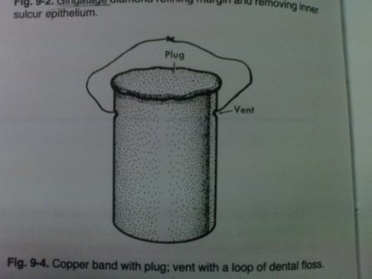
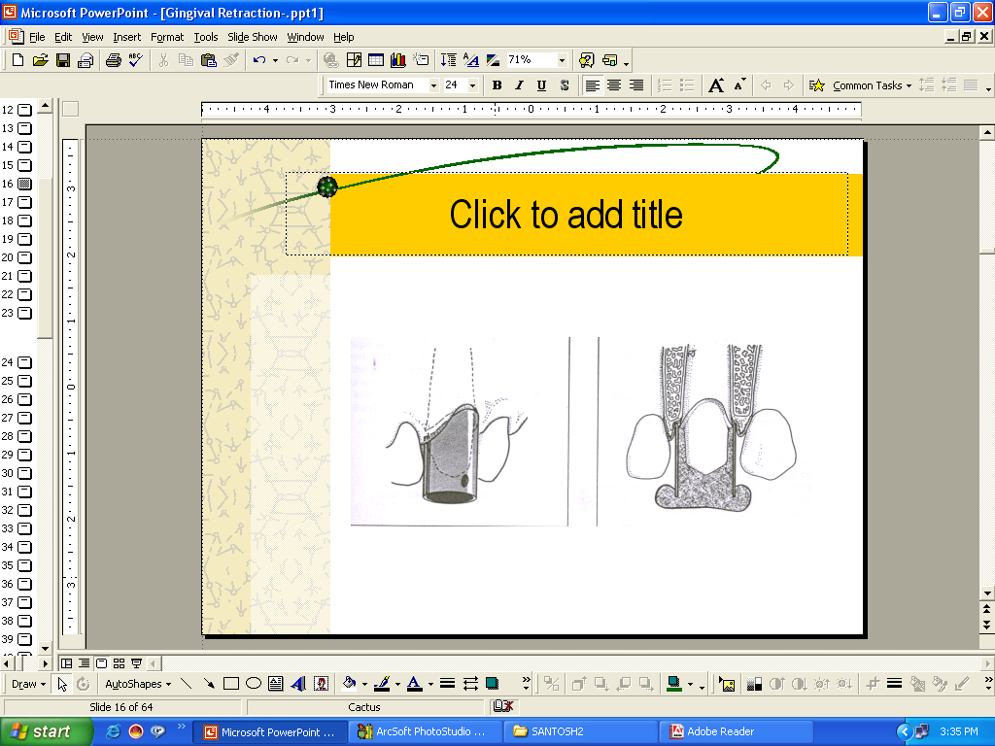
Copper bands

Slide 23
RETRACTION CORDS

Slide 24
Ready made cotton or synthetic woven cords .
Vary according to :
-size
-chemical added or chemical free
Advantage –
Compact
Non adhesive
Disadvantage –
Difficult to insert in sulcus .
Notes:
Metallic or resin wire wrapped around them

Slide 25
Classification of retraction cords
a. Depending on the configuration
Twisted
Knitted
Braided
Plain
b. Depending on surface finish
waxed
Un waxed
c. Depending on the chemical treatment
plain
impregnated

Slide 26
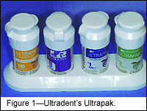
Depending on the thickness
(color coded)
black 000
yellow 00
purple 0
blue 1
green 2
red 3
Notes:
Sd be of sufficient diametre ,, to displace gingiva laterally

Slide 27
Drawn Cotton Rolls
Loose cotton rolled to desired diameter .
Already impregnated or after insertion into the sulcus .
Used subsequent to cords .
Advantage –
Easier to insert in sulcus because of looseness.
Accommodate more chemicals than cords .
Efficient in widening the trough and generate more shrinkage in free gingiva .
Disadvantage -
Removal is difficult .
Notes:
Coagulated sealing memb. Bleeding and fluid seepage.

Slide 28
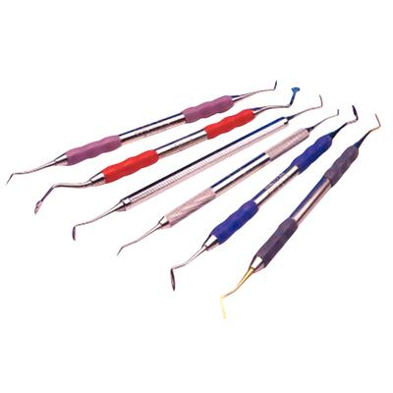
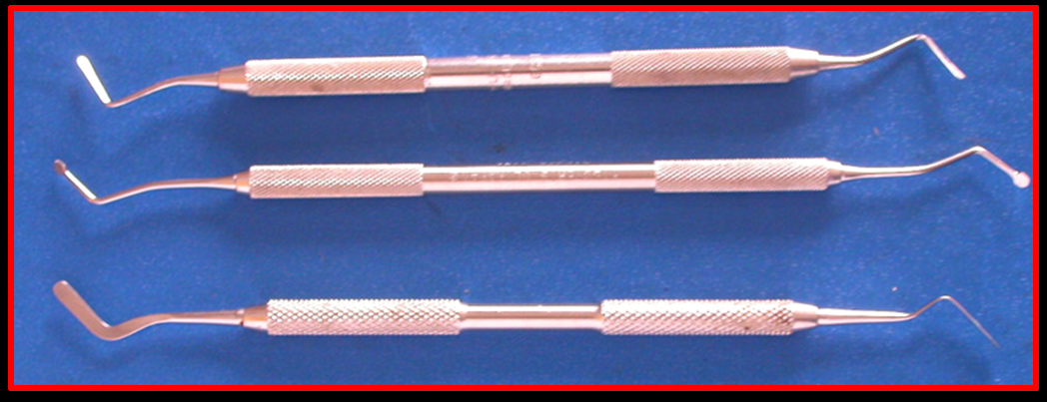
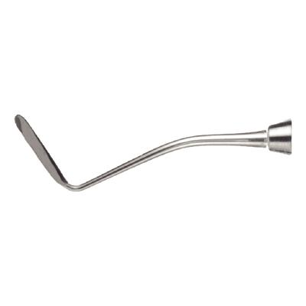
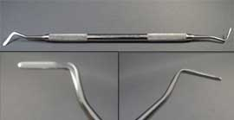
Technique for Cord Insertion
Notes:
TN010 double ended cord packer

Slide 29
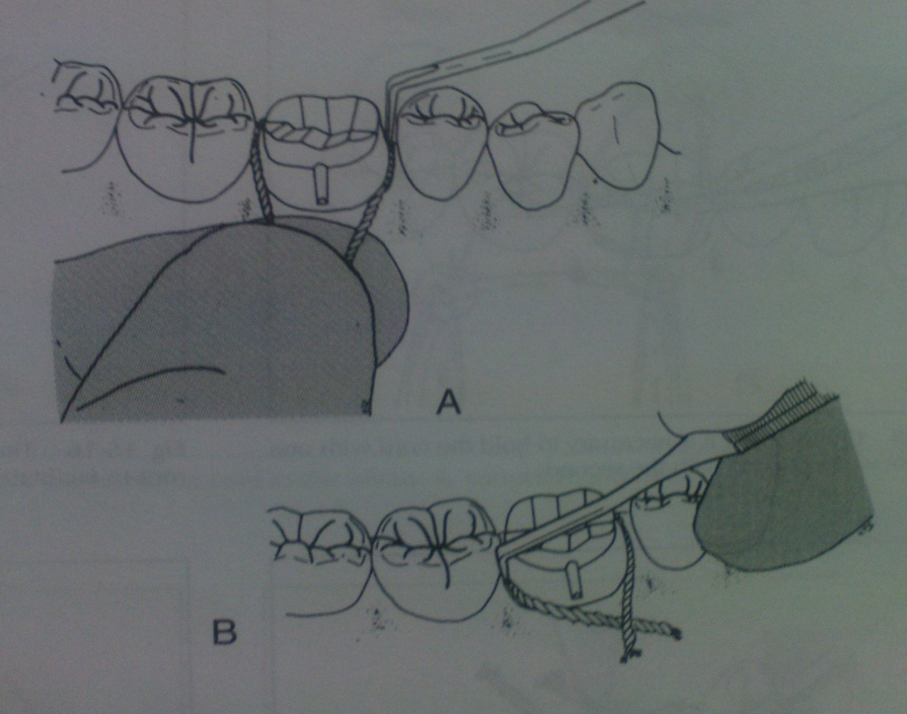
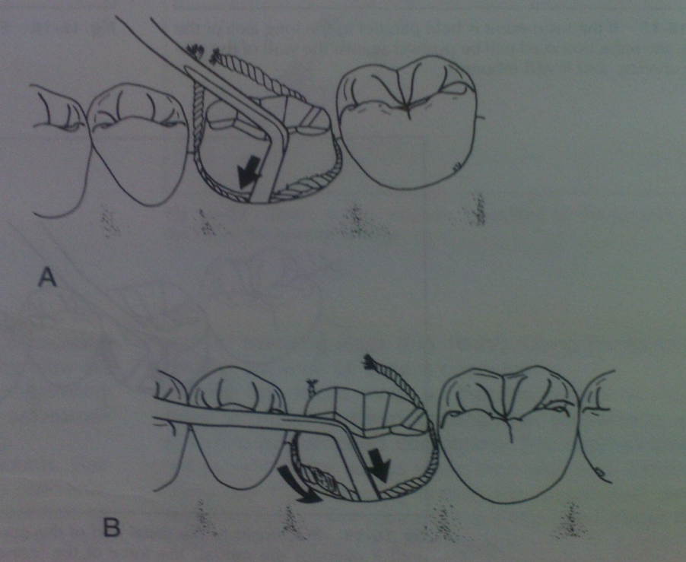
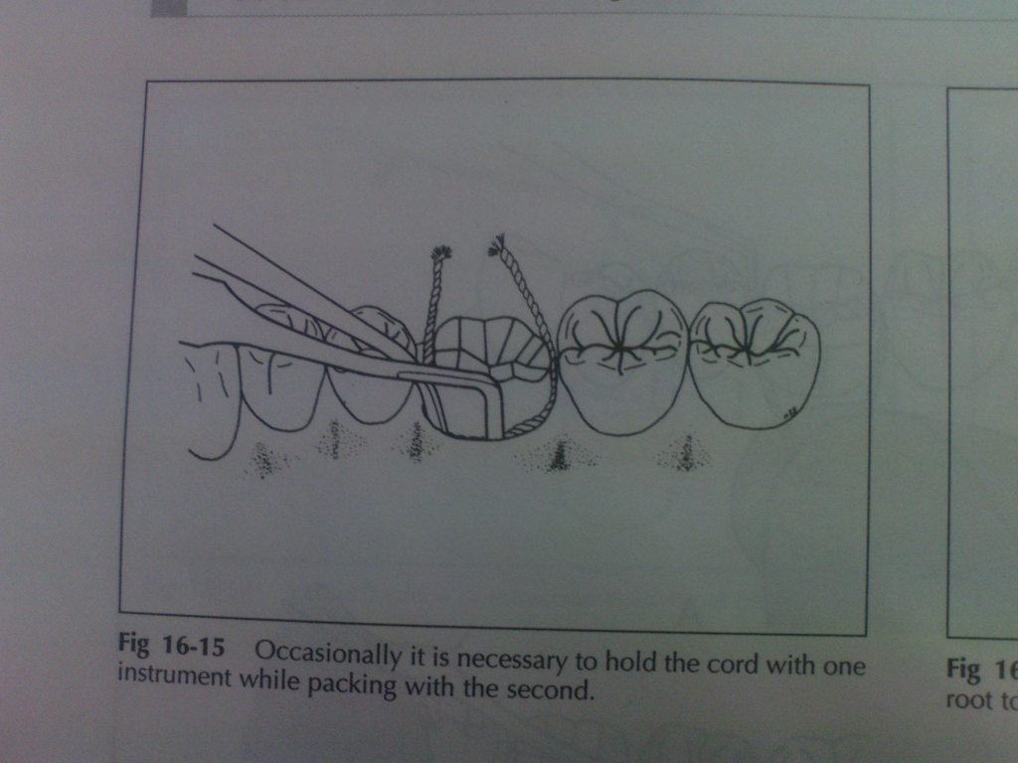

Slide 30
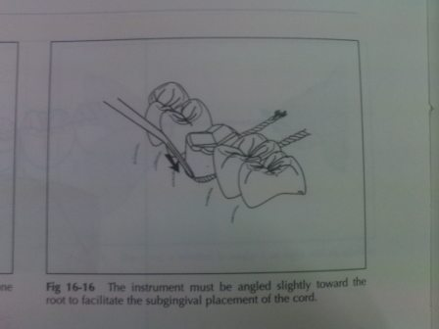
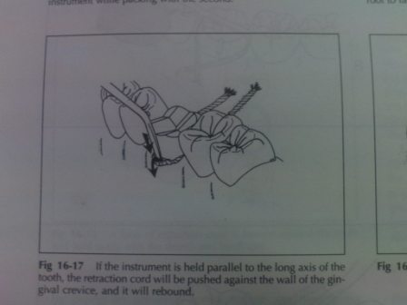
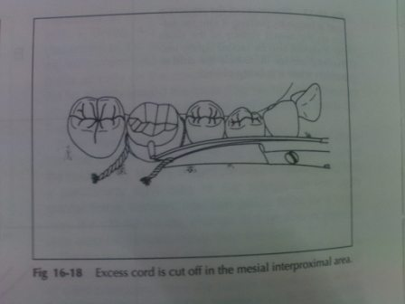
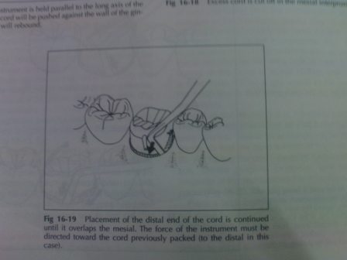

Slide 31
Techniques for gingival displacement
Single cord technique.
Double cord technique.
Infusion technique.
Every other tooth technique.

Slide 33
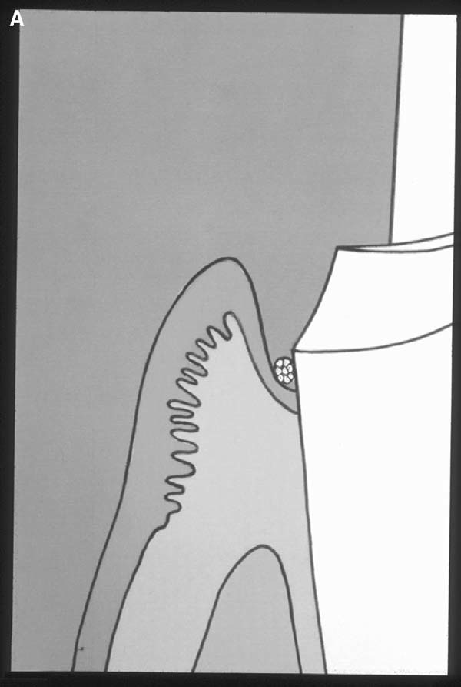
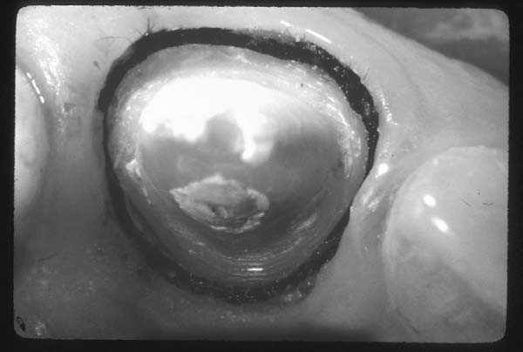

Slide 34
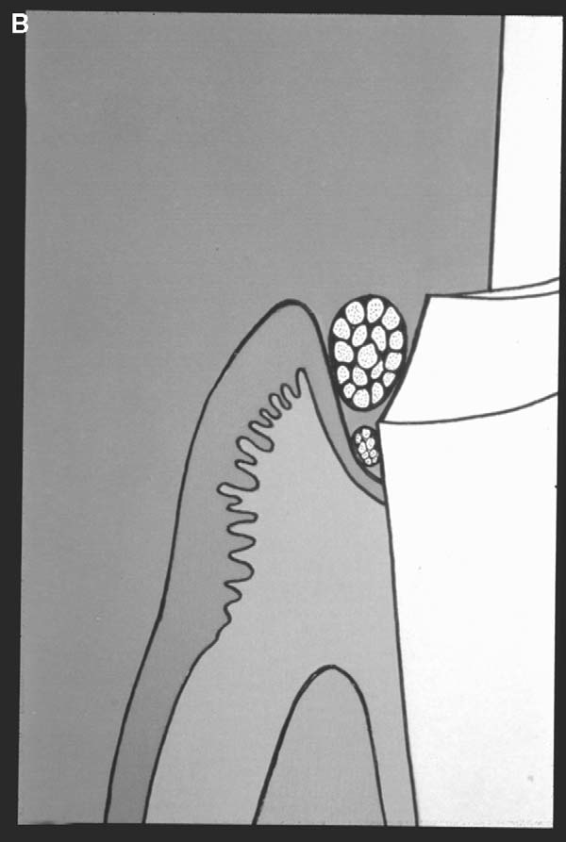
Double Cord Technique

Slide 35
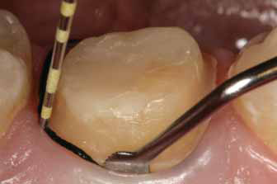
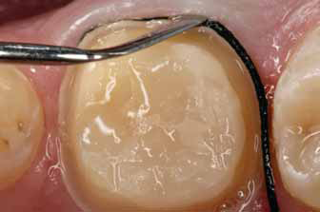

Slide 36
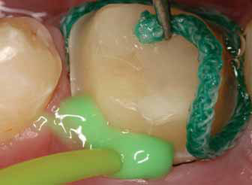

Slide 38
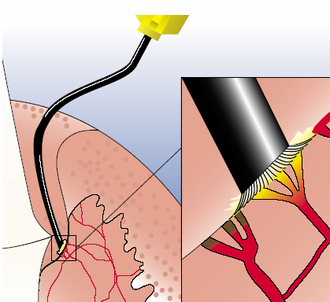
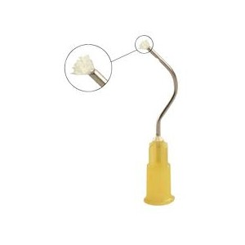
Infusion Technique
Notes:
Dento infusor with ferric sulfate medicament . Blunt, bent cannula with padded brush enables gentle pressure on the sulcus

Slide 39
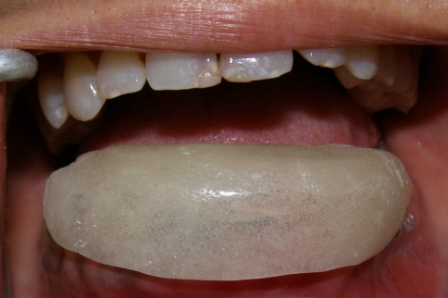
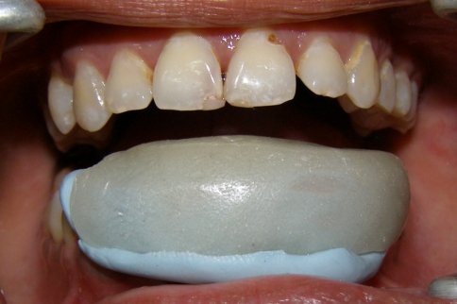
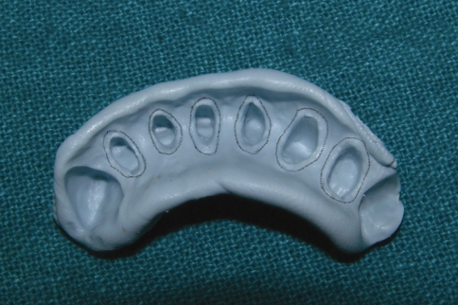
Every Other Tooth Technique

Slide 40
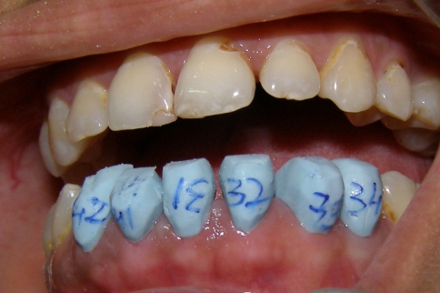
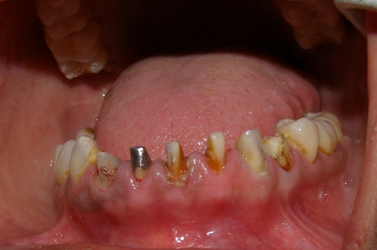
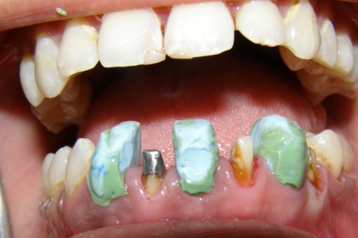

Slide 41
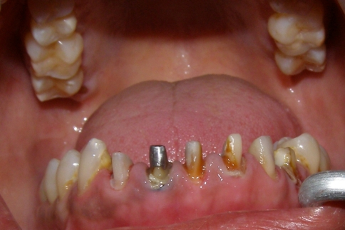
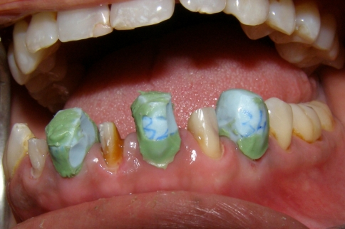
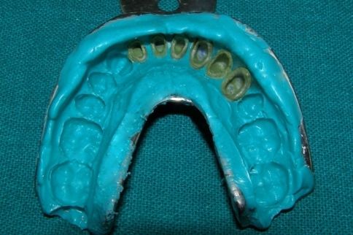

Slide 42
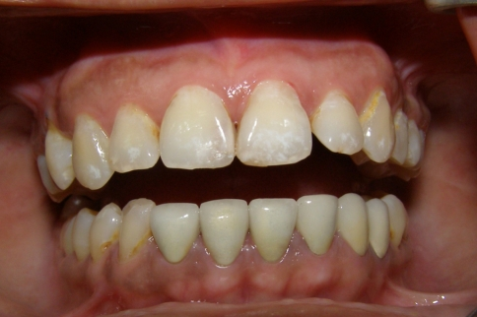

Slide 43
Teaching Materials
Operative dentistry: modern theory and practice ;M.A. Marzouk
Shillingburg:Fundamentals of fixed Prosthodontics.
sturdevent’s textbook of operative dentistry
Current concepts in gingival displacement,DCNA 48(2004),433-444.
Current methods of finish-line exposure by practicing prosthodontists. J Prosthodont l999;8:163.

Slide 44
TAKE HOME MESSEGE/ FOR THE TOPIC COVERED (SUMMARY)
There are a variety of techniques and materials that allow the clinician to manage the gingival tissues during restoration and when making an impression.
Gingival displacement is relatively simple and effective when dealing with healthy gingival tissues.
Of the various types of methods available, in most cases, gingival retraction cord along with haemostatic agents is the most effective method for retracting tissue to the depth of the sulcus.

Slide 45
Every method has its advantages and indications. In any case, the control of the soft tissue for exposing the margins of the tooth preparation for restoration and impression making is critical.
It would be worthwhile for the clinician to understand all the choices available.

Slide 46
Question & Answer Session
Describe various ways of gingival tissue management?
Describe mechanical method in detail?

Slide 47
References
Operative dentistry: modern theory and practice ;M.A. Marzouk
Shillingburg:Fundamentals of fixed Prosthodontics.
Current concepts in gingival displacement,DCNA 48(2004),433-444.
Current methods of finish-line exposure by practicing prosthodontists. J Prosthodont l999;8:163.
Tissue management with a new gingival retraction material: a preliminary clinical report.J Prosthet Dent 1996;75:242.
Clinical trail of gingival retraction cords.J Prosthet Dent 1999:81:258.

Slide 48


